Slide 2
Challenges in Interpreting Ultrafast Spectroscopy Data: A Case for Machine Learning in
Materials Research
Muhammed Arshad Thottappali
Institute of Macromolecular Chemistry
Prague, Czech Republic

Slide 3
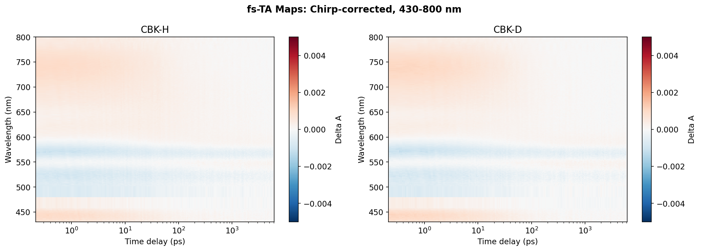
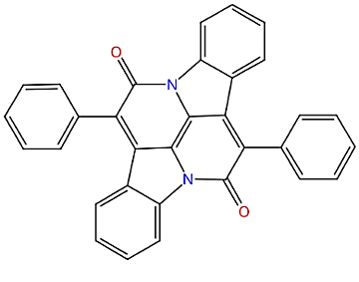
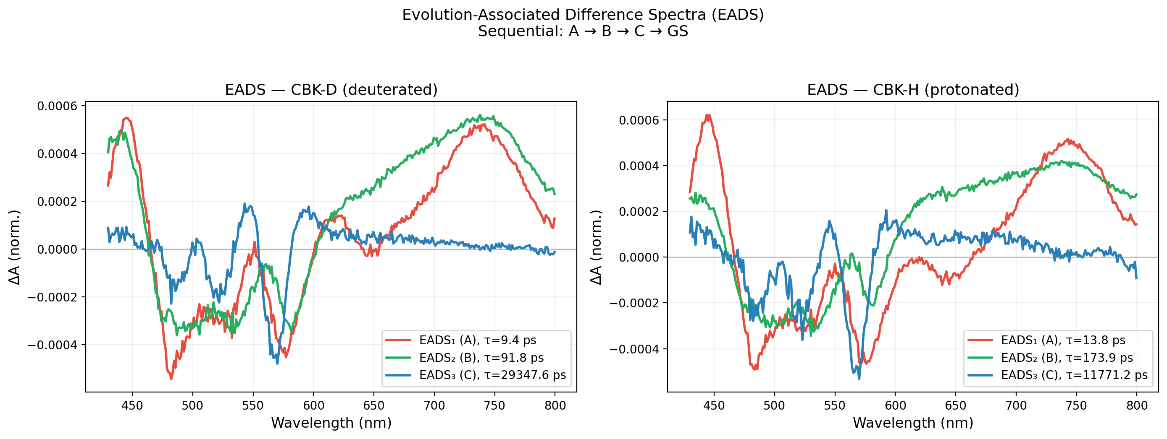
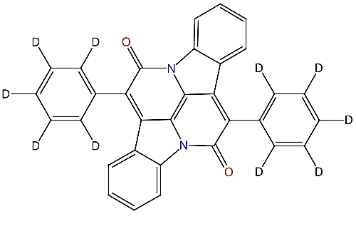
Selecting the Decay Pathways
The Goal: Extract kinetic lifetimes to measure the Isotope Effect in H vs. D
The Classical Approach: Global analysis with simple model
Heavier Deuterated molecule appears to relax faster
Data-driven way to "see" the decay?
Notes:
My research aims to extract chemical kinetics from complex ultrafast spectroscopy data, specifically looking at the Kinetic Isotope Effect in Cibalackrot. The problem? Standard analysis tools force us to guess the underlying reaction pathway. When we guessed a standard sequential pathway, the math fit perfectly, but the physics was impossible—the heavier deuterated molecule appeared to react faster. This is the danger of human bias: forcing the wrong model onto the data gives you scientifically flawed lifetimes. Because human bias failed us, we realized we had to stop guessing. We needed a tool that could look at the raw data and tell us the true shape of the reaction without any preconceived chemical notions. That is exactly why we turned to Deep Learning..."

Slide 4
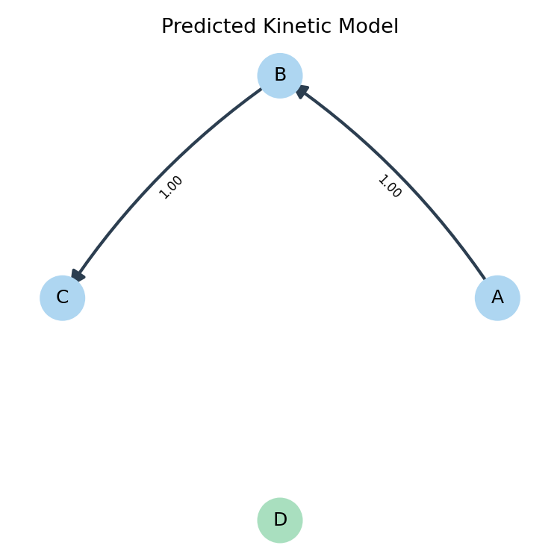
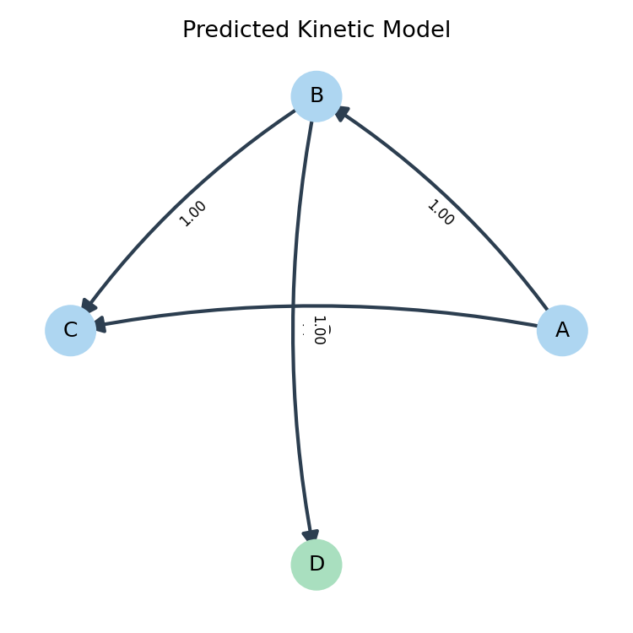
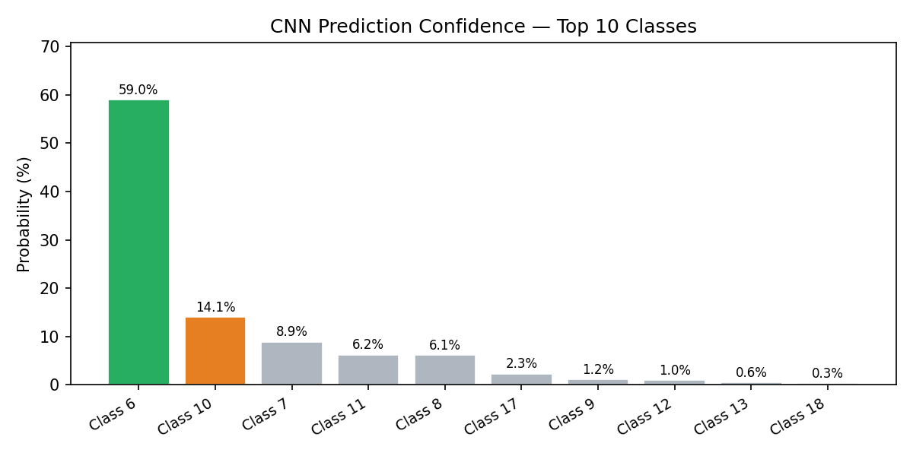
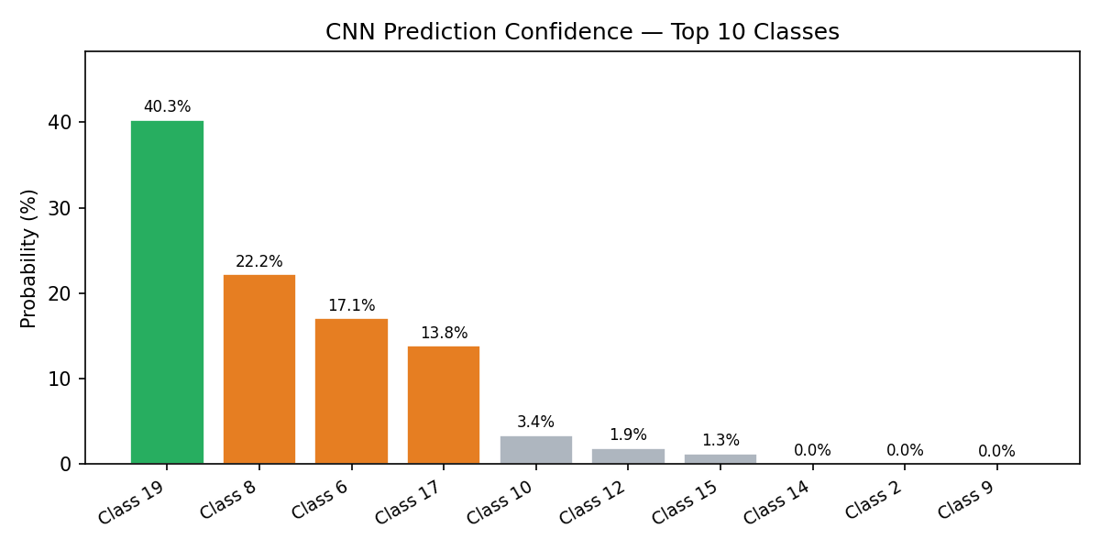
Understanding Pathways via Deep Learning
Open-source "DeepSKAN" code (Kollenz, 2020) as a potential solution to our bias problem.
The Challenge: The original code struggled with our specific experimental conditions
The AI-Assisted Upgrade: modernize the architecture into a custom PyTorch model.
Added "Adaptive Pooling" so the network can automatically accept 2D heatmaps of any size or resolution.
Added "Batch Normalization" and "Dropout" layers to stop the model from getting confused by real-world experimental noise.
https://pubs.acs.org/doi/10.1021/acs.jpcb.0c04299
Notes:
When looking for an unbiased solution, I found the DeepSKAN paper by Philipp Kollenz. I downloaded their GitHub code, but quickly realized it struggled with the noise and resolution of my specific experiments. Since I am a experimental physiscst , not a computer scientist, I used AI to help me upgrade their code. modernized the architecture—adding adaptive pooling so it accepts any image size, and batch normalization to make it robust against experimental noise. This allowed us to successfully apply deep learning to our real-world Cibalackrot data."

